Slide 1
大道至简
Tools 工具
Analytical Techniques
& Methods
分析技术和方法
COOP experience
经验
OFFER
Business Knowledge
业务知识

Slide 2
怎么做规划？
根据自身情况做出计划
初级数据分析师课
中高级课
2 months
COOP
2 months
3 months

Slide 3
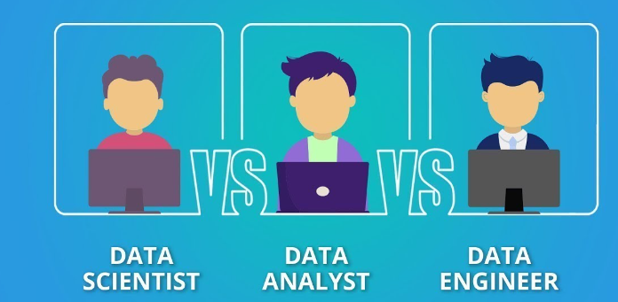
数据职位分类

Slide 4
数据行业分类
Data Engineer
A data engineer is an IT worker whose primary job is to prepare data for analytical or operational uses. These software engineers are typically responsible for building data pipelines to bring together information from different source systems.
Data engineer skill set
C#, Java, Python, R, Ruby, Scala and SQL.
ETL tools and REST-oriented APIs
data warehouses and data lakes
NoSQL databases and Apache Spark systems
Business intelligence (BI) platforms
machine learning
Unix-based operating systems

Slide 5
数据行业分类
Data Scientist
A data scientist is a professional responsible for collecting, analyzing and interpreting extremely large amounts of data. The data scientist role is an offshoot of several traditional technical roles, including mathematician, scientist, statistician and computer professional. This job requires the use of advanced analytics technologies, including machine learning and predictive modeling.
Data Scientist skill set
C#, Java, Python, R, Ruby, Scala and SQL.
Unix-based operating systems
Hadoop, Pig, Hive, Spark and MapReduce
data mining, machine learning, deep learning,
the ability to integrate structured and unstructured data.
Experience with statistical research techniques, such as modeling, clustering, data visualization and segmentation, and predictive analysis, are also a big part of the roles.

Slide 6
数据行业分类
Data Analyst
A data analyst collects, cleans, and interprets data sets in order to generate actionable insight answer a question or solve a problem or support decision-making. They work in many industries, including business, finance, criminal justice, science, medicine, and government.
Data Analyst skill set
Business senses and domain knowledge
Tableau, Power BI, SQL, Python.
Experience with statistical research techniques, such as modeling, clustering, data visualization and segmentation, and predictive analysis

Slide 7
数据职位分类
For 转行，零基础，快速高薪

Slide 8

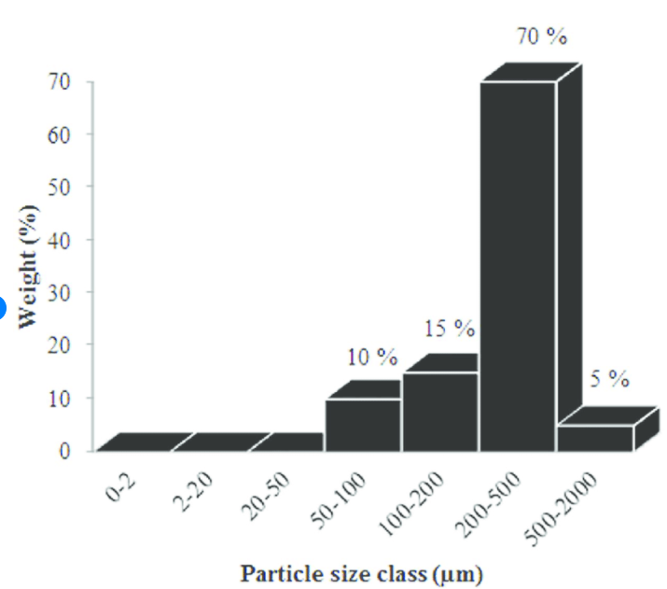

理论：到底什么是数据分析？
Good Quality or Bad Quality?
Entropy High(no info) → Low(more info)

Slide 9
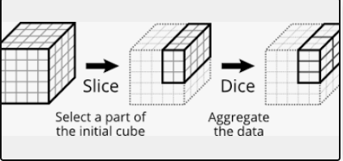
技术三板斧
三板斧：切，统计总和，比较

Slide 10


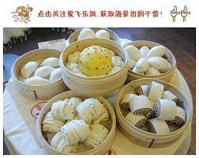
技术三板斧（面团版）
三板斧：切，统计总和，比较

Slide 11
常用 Analytical Techniques and methodologies分析技巧和方法
Slice and Dice (切面团）
Funnel Analysis
Cohort Analysis
RFM(recency, frequency, monetary)
Correlation analysis
A/B testing
Regression
Clustering
Time series

Slide 12
学什么工具？
根据市场需求

Slide 13
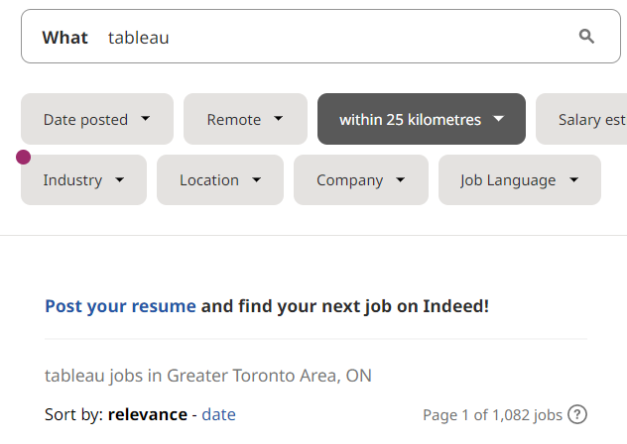
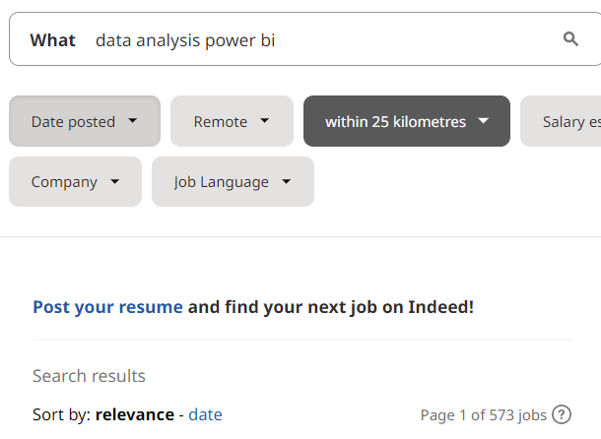
学什么技术？

Slide 14
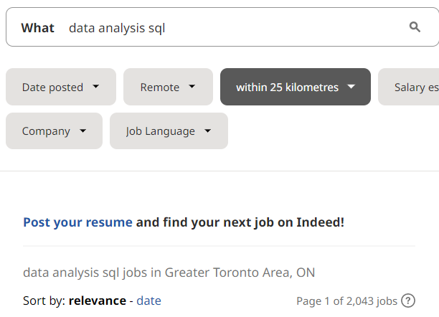
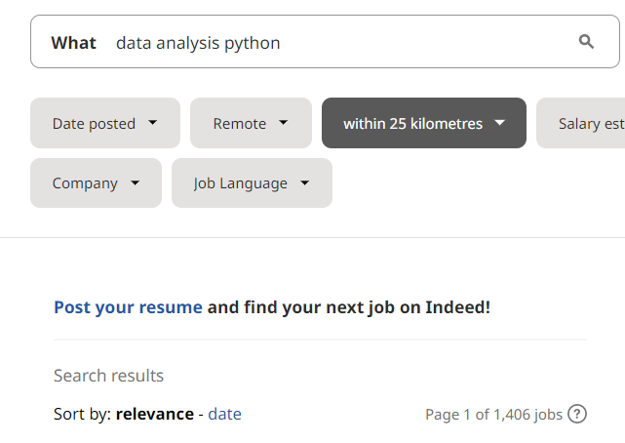
学什么技术？

Slide 15
怎么学技术？
1% 原则
只学最常用的工具，只学面试工作中的应用
工具基础 --- 学习工作常用工具已经如何使用这些工具
  POWER BI --- 工作常用设计，收集，准备，MODEL，分析，视觉化
  TABLEAU ---工作常用设计，收集，准备，分析，视觉化
  Python --- 基本语法，工作常用 Python Modules, Packages, Libraries
  SQL --- 基本语法，工作常用QUERIES,STATEMENTS

Slide 16
Other Python Courses/其他课例子1
Variables
Expressions and Statements
Comments
Data Types
Operators
Arithmetic Operators
Comparison Operators
Boolean Operators
Bitwise Operators
is & in Operators
Ternary Operator
Strings
String Methods
F-strings
Escaping Characters
String Characters & Slicing
Booleans
Number Data Types
Enums
User Input
Control Statements
Lists
Sorting Lists
Tuples
Dictionaries
Sets
Functions
Variable Scope
Nested Functions
Closures
Objects
Loops
Break and Continue
Classes
Modules
Arguments from Command Line
Lambda Functions
Map, Filter, Reduce
Recursion
Decorators
Docstrings
Annotations
Exceptions
With
Installing Packages with pip
List Compression
Polymorphism
Operator Overloading

Slide 17
Other Python Courses/其他课例子2
Lesson 1: Introduction
Lesson 2: gitHub, Functions, Booleans and Modules
Lesson 3: Sequences, Iteration and String Formatting
Lesson 4: Dictionaries, Sets, and Files
Lesson 5: Exceptions, Testing, Comprehensions
Lesson 6: Advanced Argument Passing, Lambda -- functions as objects
Lesson 7: Object Oriented Programming
Lesson 8: More OO -- Properties, Special methods
Lesson 9: Iterators, Iterables, and Generators
Lesson 10: Decorators, Context Managers, Regular Expressions, and Wrap Up

Slide 18
工作用数据分析Python三大use cases
Data Preparation
Data Analysis
Automation

Slide 19
在真实工作环境中做项目
数据分析工作分门别类但是基本流程是一样的：
数据分析工作流程
Business process/业务流程
  Project process项目流程
    Data process/数据流程

Slide 20
数据分析工作流程
Business process/业务流程
Identify/understand business goals/problems/opportunities
Review documents and interview SME(Subject Matter Expert)
Convert business problems to metrics. Discuss metrics with stakeholders
Propose data solutions to the problems/opportunities identified
    Identify & meet with stakeholders
    Set & prioritize goals
    Collect business requirements
    Define deliverables
    Create project schedule
    Identify risk /potential roadblocks
      Data collection
      Data preparation
      Data Analysis
      Data visualization/reporting
      Data productization
    Testing
Present solution/story telling
Project process/项目流程
Data process/数据流程

Slide 21
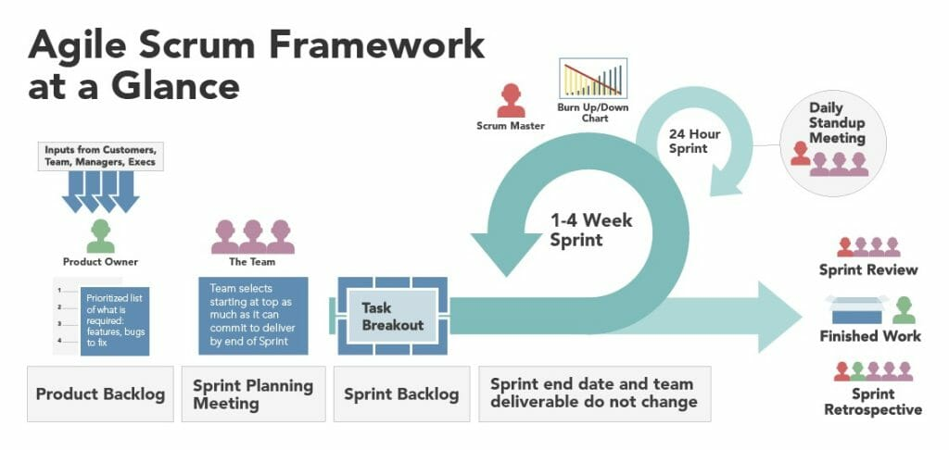
COOP实习解决什么问题？
Agile Methodology

Slide 22

All in one 一站式服务
Business Data Analysis
初级商务分析师课程 --- 让你无背景和基础转行
  POWER BI 基础
  SQL 和 PYTHON 课帮助你进阶中高级分析师
中高级商务数据分析师项目课 --- 帮助大家扩大申请职位范围和资深高薪职位(8-10万年薪）
  Sales Analytics 销售3个项目
  Marketing analytics 市场营销分析项目
  Credit analytics 信贷分析项目
  Audit/Risk analytics 内部审计风险分析项目
  HR Analytics 人事数据分析项目
  更多项目加入中…
COOP实习 --- 北美公司最先进的工作流程和经验，面试和工作不再慌
  Documentation training/文档训练
  Agile project process 最先进项目流程训练
  Most popular platform/tools 最先进流行的工具
    Confluence, Jira and GitHub
就业保证--- 保姆式一对一服务拿OFFER
  一对一简历修改
  一对一面试辅导
  一对一面试英语辅导
  就业后服务

Slide 23
All in one 一站式服务
Business Data Analysis
初级商务分析师课程 --- 让你无背景和基础转行
  POWER BI 基础 和Tableau 基础
  SQL 和 PYTHON 课帮助你进阶中高级分析师
帮你划重点

Slide 24
商务数据初级分析师课程 --- 让你无背景和基础转行
  POWER BI Financial Analysis 项目和Tableau Account Receivable 项目
  SQL 和 PYTHON 课帮助你进阶中高级分析师
工具基础课---简历面试常用 POWER BI
Get data
Prepare your data
Model your data
Write a measure in DAX
Build your report
Format the report
Finished report
Save your report

Slide 25
商务数据初级分析师课程 --- 让你无背景和基础转行
  POWER BI Financial Analysis 项目和Tableau Account Receivable 项目
  SQL 和 PYTHON 课帮助你进阶中高级分析师
工具基础课---简历面试常用 TABLEAU
1: Connect to and Transform Data
1.1. Connect to data sources
1.2. Prepare data for analysis
1.3. Customize fields
2: Explore and Analyze Data
2.1. Create calculated fields
2.2. Create quick table calculations
2.3. Create custom table calculations
2.4. Create and use filters
2.5. Create parameters to enable interactivity
2.6. Structure the data
2.7. Map data geographically
2.8. Summarize, model, and customize data by using the Analytics feature
3: Create Content
3.1. Create charts
3.2. Create dashboards and stories
3.3. Add interactivity to dashboards
3.4. Format dashboards
4: Publish and Manage Content on Tableau Server and Tableau Online
4.1. Publish Content
4.2. Schedule data updates
4.3. Manage Published workbooks

Slide 26
商务数据初级分析师课程 --- 让你无背景和基础转行
  POWER BI Financial Analysis 项目和Tableau Account Receivable 项目
  SQL 和 PYTHON 课帮助你进阶中高级分析师
工具基础课---面试工作常用 SQL
SELECT Statement Practice
where Statement Practice
JOIN Statement Practice
INNER JOIN Statement Practice
RIGHT & LEFT JOIN Statement Practice
union Statement Practice
Union vs union all Statement Practice
intercept vs except Statement Practice
aggregation Statement Practice
SORT Statement Practice
Group by Statement Practice
Having Statement Practice
String Statement Practice
Date Statement Practice
null Statement Practice
cast Statement Practice
derived Statement Practice
with Statement Practice
case Statement Practice
Create, insert, update, delete Statement Practice

Slide 27
商务数据初级分析师课程 --- 让你无背景和基础转行
  POWER BI Financial Analysis 项目和Tableau Account Receivable 项目
  SQL 和 PYTHON 课帮助你进阶中高级分析师
工具基础课---简历面试常用 Python
Python Modules,
Packages, Libraries
Object creation
Viewing data
Selection
Missing data
Operations
Merge
Grouping
Reshaping
Time series
Categoricals
Plotting
Getting data in/out
Error handling

Slide 28
怎么学技术？
1% 原则
只学最常用的工具，只学面试工作中的应用
工具基础 --- 学习工作常用工具已经如何使用这些工具
  POWER BI --- 工作常用设计，收集，准备，MODEL，分析，视觉化
  TABLEAU ---工作常用设计，收集，准备，分析，视觉化
  Python --- 基本语法，工作常用 Python Modules, Packages, Libraries
  SQL --- 基本语法，工作常用QUERIES,STATEMENTS

Slide 29
常用 Analytical Techniques 分析技巧
Funnel Analysis
Cohort Analysis
RFM(recency, frequency, monetary)
Correlation analysis
A/B testing
Regression
Time series

Slide 30
Business Data analysis/商业数据分析
Category of jobs /招聘数据分析的部门分类
Sales/销售
Marketing/营销
Internal Audit/Risk/风控
Credit/信用
HR/人事

